Slide 1
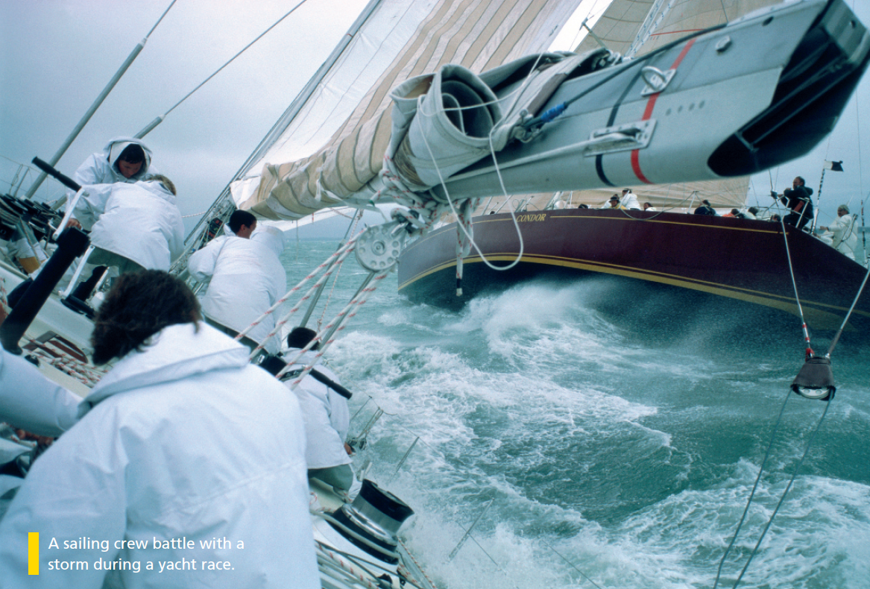

Bringing the world to the classroom and the classroom to life
NGL.CENGAGE.COM/ELT
A PART OF CENGAGE

Slide 2

3a Underwater
Reading on assignment
1 Read the stories by Brian Skerry about his yearlong assignment photographing sharks. Write the number of the story (1–2) next to the question. There is one extra question.
2
a What was one of your worst experiences covering this story?
b What was one of your strangest experiences covering this story?
c What was one of your best experiences covering this story?
1
3a-p. 20

Slide 3

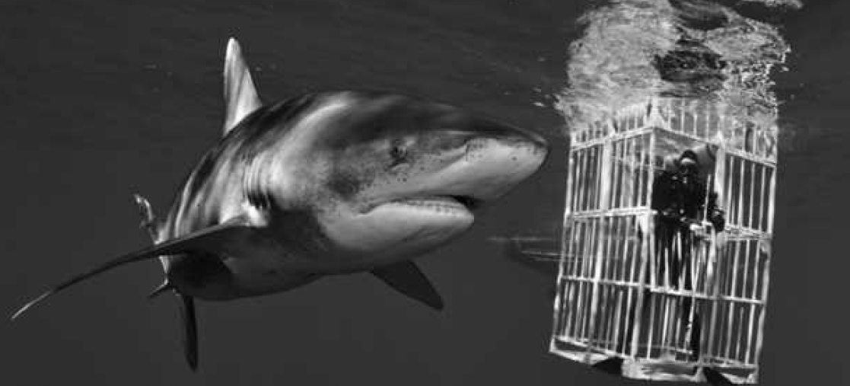
1
Finding the oceanic whitetip shark is an experience I won’t forget. This is one of the most dangerous sharks in the world, but its numbers are falling. They used to be common around the Bahamas, but most people say they haven’t seen them for years. Just as we arrived there, some sports fishermen in the central Bahamas saw some oceanic whitetips when they were fishing for tuna. So I planned sixteen days to go searching for them.
For the first few days out of Palm Beach, we didn’t see a thing. Then, on the fifth day, I was looking out from the bridge when I spotted a shark on the surface. The white tip of its dorsal fin was sticking out of the water, so I knew we had an oceanic whitetip. I quickly put on my wetsuit and jumped in the water. The shark was very curious about me and swam right up to me. It was about three metres long and it even stayed around while we were putting the cage in the water for the scientist. I got some great pictures! That was really the high point of the assignment.
3a-p. 20

Slide 4
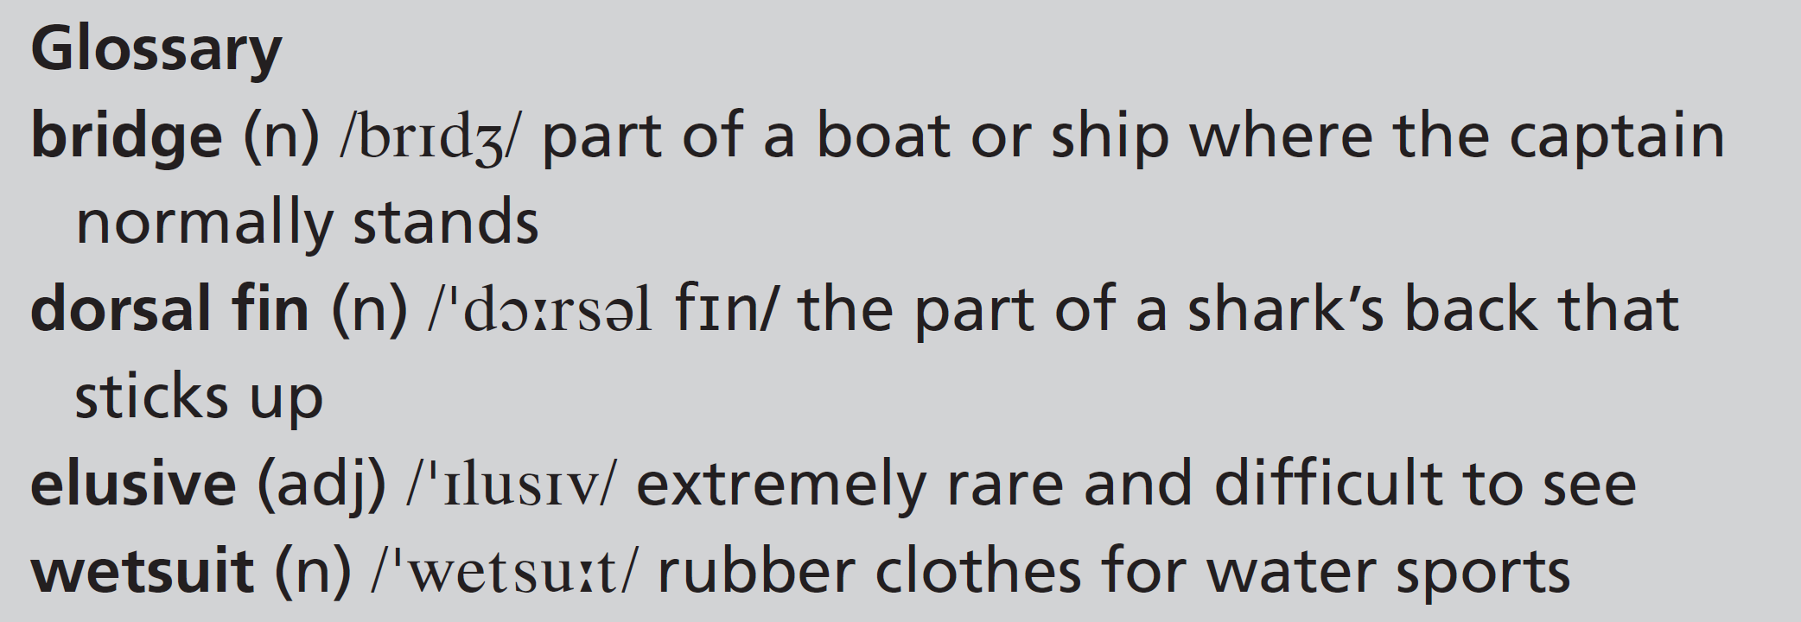
2
At the end of the assignment, after a year of work, we were going after the great hammerhead shark. This species is so elusive that there are hardly any pictures of it. For the entire first week, the weather was appalling and it was impossible to dive. It was very frustrating. Then, on the eighth day, my assistant had to fly home because his mother was seriously ill.
Suddenly, I was working alone as well as trying to deal with the bad weather. That was definitely the worst moment on the assignment. It is so important to have a really good assistant with you. Without him there, my workload more than doubled. While I was trying to decide what to do, the weather unexpectedly improved and I got a couple of not-bad days! And on one of those days, everything clicked and I got some great pictures of a hammerhead. I was lucky.
3a-p. 20

Slide 5
2 These statements are true for one or both of Skerry’s stories. Write W (whitetip), H (hammerhead) and B (both).
B
H
W
H
W
W
H
B
1 The sharks were difficult to find.
2 Bad weather made it almost impossible to do any work.
3 Some fishermen told Skerry where the sharks were.
4 Skerry had to work without an assistant.
5 Skerry got into the water as soon as he saw a shark.
6 The shark spent some time swimming close to Skerry.
7 Skerry wasn’t sure what to do.
8 Skerry was pleased with the photos he took.
3a-p. 20

Slide 6
3 Find these words and expressions in the stories. Choose the correct option.
1 spotted: photographed / saw
2 high point: best moment / top of the boat
3 deal with: survive / solve the problem
4 workload: amount of work you have to do / problems
5 doubled: increased by twice as much / increased by three times as much
6 clicked: was quiet / was successful
3a-p. 20

Slide 7
Grammar past simple and past continuous
4 Write questions for these answers. Use the information from the stories.
1 When ____________________________________________________?
When they were fishing for tuna.
2 When ____________________________________________________?
While he was looking out from the bridge.
3 How _____________________________________________________?
Because the white tip of its dorsal fin was sticking out of the water.
4 What ____________________________________________________?
They were going after the great hammerhead shark.
5 What ____________________________________________________?
Skerry’s assistant flew home.
6 What _____________________________________________________?
He was trying to decide what to do.
did the sports fishermen see some oceanic whitetips
did Brian Skerry spot a shark
did he know that it was a whitetip
were Skerry and his assistant going after at the end of the assignment
happened on the eighth day
was Skerry doing when the weather improved
3a-p. 21

Slide 8
5 Complete the sentences with the correct form of the verbs in brackets.
1 We ______________ a shark when we ______________.
(see / surf)
2 I ______________ back into the boat when I ______________ my camera into the water.
(climb / drop)
3 It ______________ a beautiful morning. The sun ______________ over the horizon and the fish ______________.
(be / come up / jump)
4 It ______________ to rain while we ______________ a really good sequence.
(start / film)
5 We ______________ in the boat, quickly ______________ our equipment and ______________ home.
(get / pack up /go)
6 While we ______________ back to land, the wind suddenly __________ a lot stronger.
(sail / get)
saw
were surfing
was climbing
dropped
was
was coming up
were jumping
started
were filming
got
packed up
went
were sailing
got
3a-p. 21

Slide 9

6 Pronunciation d and t after -ed endings
a Underline the verbs with -ed endings and the word that follows.
1 I climbed down the side of the boat.
2 We decided to go for a swim.
3 The shark looked dangerous, so I swam away.
4 I dropped Tom’s camera into the water.
5 I learned to swim when I was five.
6 The sun came out and the sea turned deep blue.
b Listen and repeat the sentences.
Track 17
3a-p. 21

Slide 10
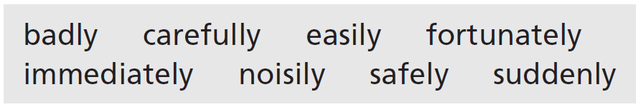
Vocabulary describing experiences
7 Complete the sentences with these adverbs. Sometimes you can use more than one adverb.
1 The shark ______________________ turned and swam towards me.
2 The lake wasn’t very big and we swam across it __________________.
3 I got out of the kayak very __________________ so that I didn’t fall in the river.
4 The children ran __________________ down the beach to the sea.
5 We dived into the water and __________________ saw some beautiful fish.
6 I tried windsurfing, but I did it so __________________ that I gave up after ten minutes.
7 I had an accident when I was jet-skiing, but __________________ it wasn’t serious.
8 When you’re diving, you need to make sure you come up to the surface __________________.
immediately / suddenly
easily / safely
carefully
immediately / noisily
immediately
badly
fortunately
carefully / safely
3a-p. 21

Slide 11

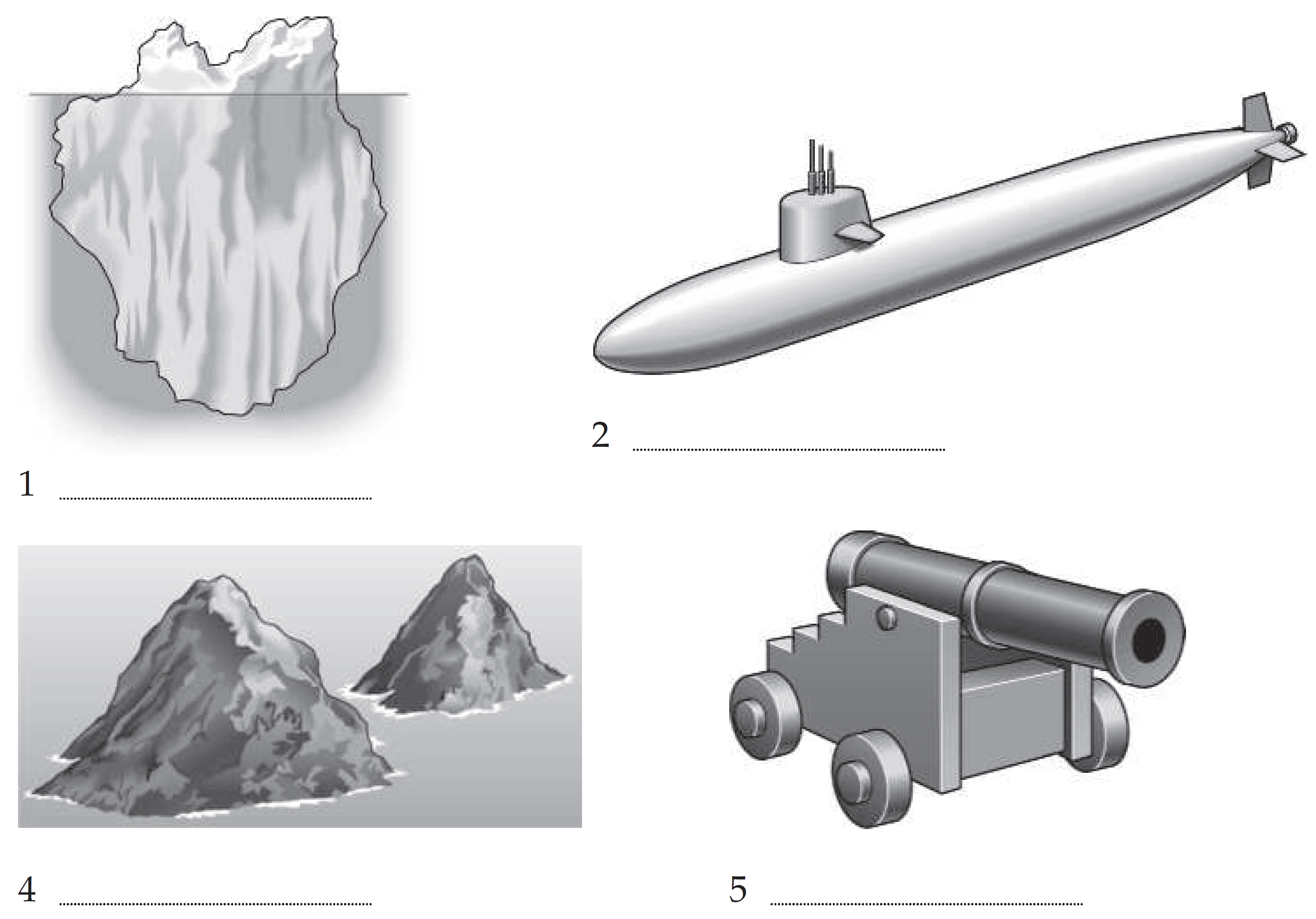
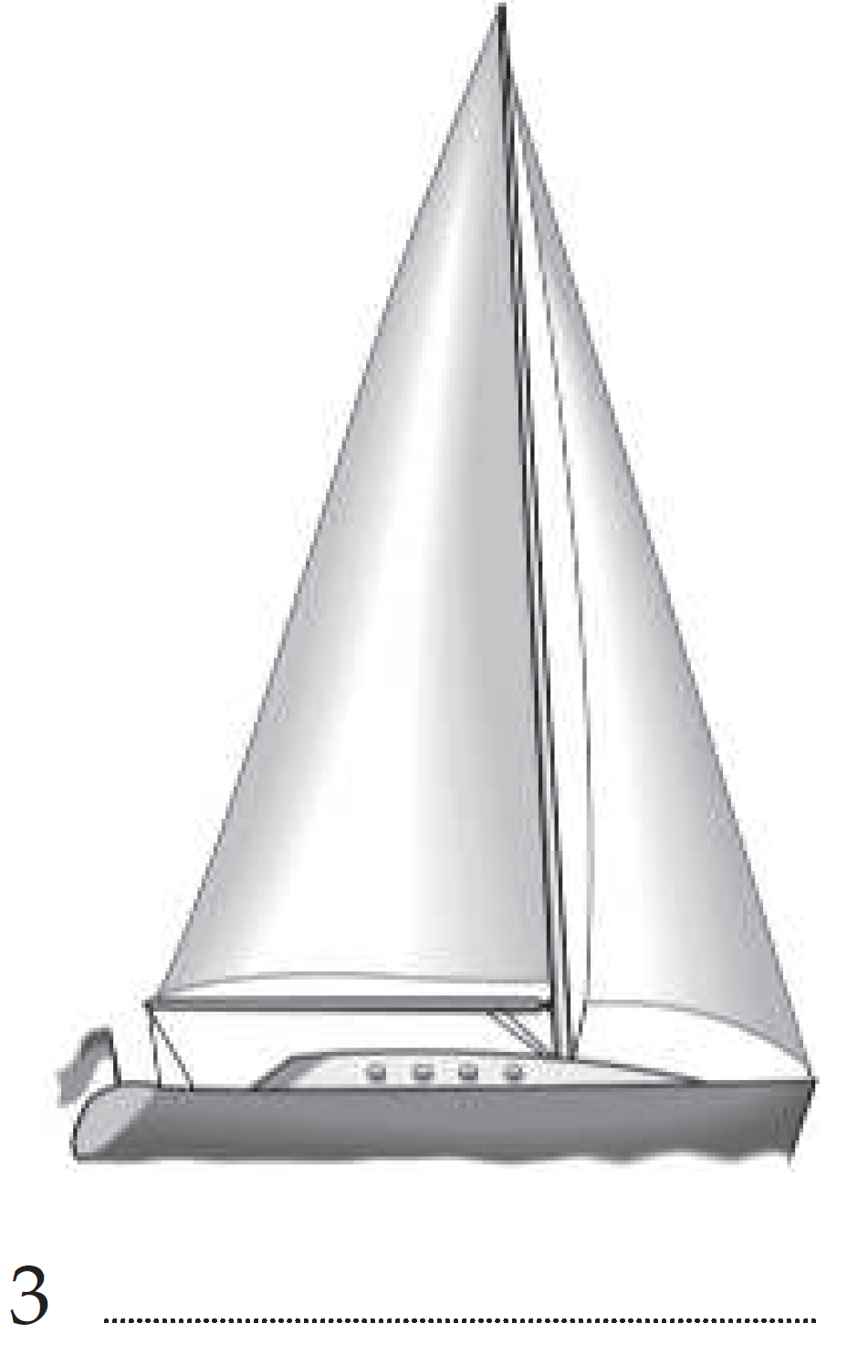
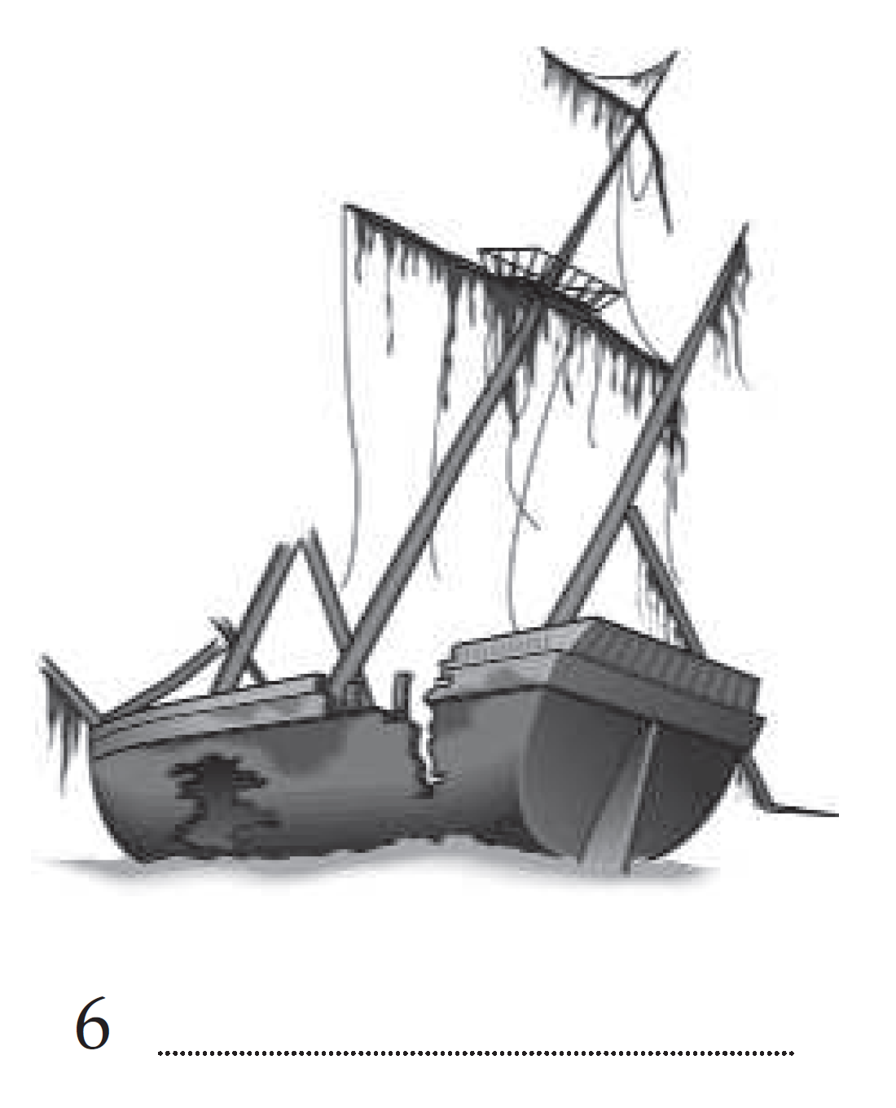
3b Problems and rescues
Vocabulary at sea
1 Write the names of these things. They are all on Student’s Book pages 36–37.
submarine
iceberg
yacht
rocks
cannon
(ship)wreck
3b-p. 22

Slide 12
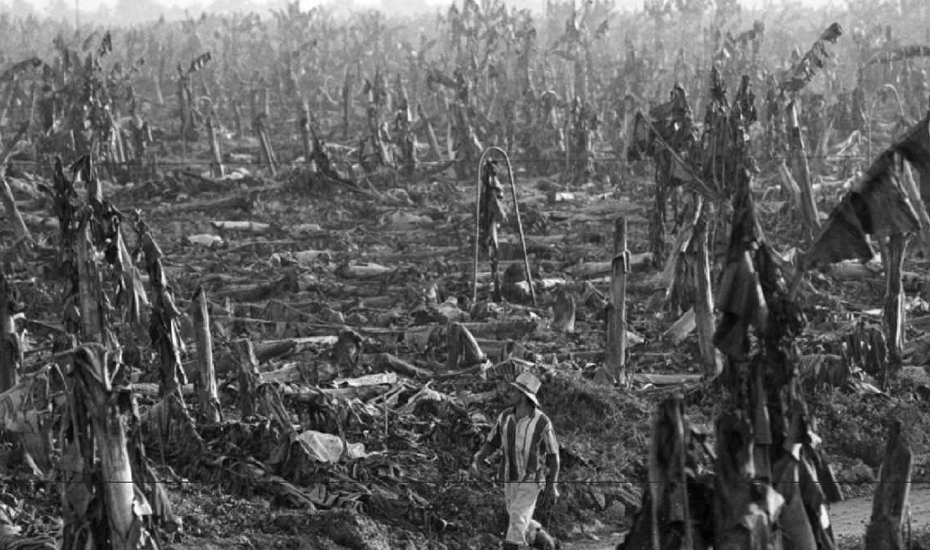
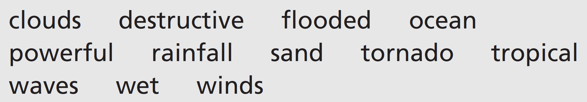
Listening Hurricane Mitch
2 What kind of landscape does the photo show? Choose one option (a–c).
a desert
b farmland
c forest
3 You are going to listen to the introduction to a programme about hurricanes. Tick (✓) the words you think you will hear. Then listen and check.
Track 18
All the words – except tornado and waves – are in the programme.
3b-p. 22

Slide 13
4 Listen again. Choose the correct option (a–c).
Track 18
1 Hurricanes begin in the … .
a Atlantic Ocean
b Indian Ocean
c Pacific Ocean
2 There is a hurricane season … .
a every month
b every year
c every ten years
3 Hurricane Mitch affected … .
a North and South America
b the Caribbean and South America
c the Caribbean and Central America
4 … fell in one day in Honduras.
a Six days’ rain
b Two months’ rain
c Two hundred days’ rain
3b-p. 23

Slide 14
Script
Track 18
Hurricanes are giant, wet and windy tropical storms. They bring winds of over 250 kilometres an hour and the hurricane clouds can carry enough water for more than nine trillion litres of rainfall in a day. Now, if you’re thinking that you don’t know the difference between hurricanes, cyclones and typhoons, don’t worry. They are actually the same thing. The different names just come from the different parts of the world – cyclones start in the Indian Ocean and typhoons in the western Pacific Ocean. Hurricanes begin in the Atlantic Ocean and there is an annual season from mid-August to late October.
One of the wettest and most destructive hurricanes in recent history was Hurricane Mitch. It hit the Caribbean and Central America in November 1998. By the time Mitch reached the coast, most people had already left the area. When the danger had passed and people had returned home, they couldn’t believe what had happened. In Honduras, farmland had turned into desert. Bridges and roads had disappeared. Rivers had changed course. As Mitch passed over Honduras, so much rain fell that some rivers flooded to six times their normal size. In one day, the area had the equivalent of 200 days of rainfall. In places where there had been rivers with lines of trees, now there was nothing. The trees had all washed away. This kind of thing is not so unusual during hurricanes, but the power of Mitch was extreme. The tremendous winds had picked up sand and carried it for many kilometres before dropping it in a new area. Suddenly, there was a desert where people had had farms. Mitch had completely changed the land and, of course, the lives of the people who lived there. It took them many years to recover.
And although there will be hurricanes in the future as powerful as Mitch, the World Meteorological Organization decided the name Mitch will never be used again.

Slide 15
5 What happened to these things during Hurricane Mitch? What was responsible: wind or water?
1 Bridges
____________________________________________________
2 farmland
____________________________________________________
3 rivers
____________________________________________________
4 roads
____________________________________________________
5 sand
____________________________________________________
6 trees
____________________________________________________
bridges had disappeared – water
farmland had turned into desert – wind
rivers had changed course – water
roads had disappeared – water
sand had moved to new areas – wind
trees had washed away – water
3b-p. 23

Slide 16
Grammar past perfect simple
6 Change the verbs to the past perfect simple where necessary.
1 By the time the storm reached land, most residents left the area.
________________________________________
2 When people got back home, they were amazed at what happened.
________________________________________
3 In some places, before the hurricane there were trees, but now there was nothing.
________________________________________
4 Many roads and bridges disappeared by the end of the first day.
________________________________________
5 After the hurricane, there was a desert where people had farms.
________________________________________
6 It became clear how much changed when people saw the satellite images.
________________________________________
most residents had left the area
at what had happened
there had been trees
roads and bridges had disappeared
where people had had farms
how much had changed
3b-p. 23

Slide 17
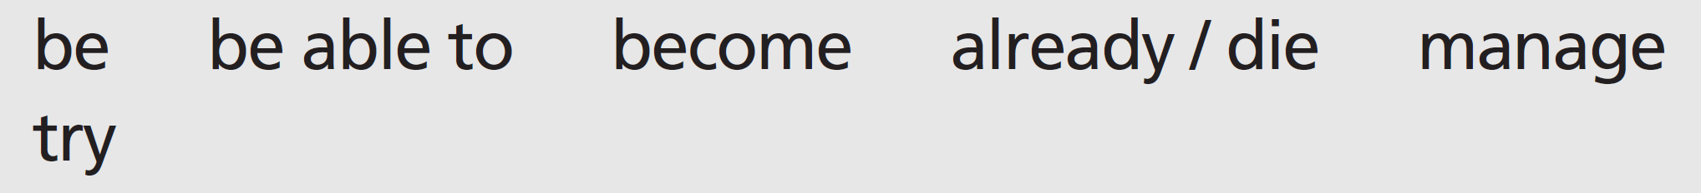
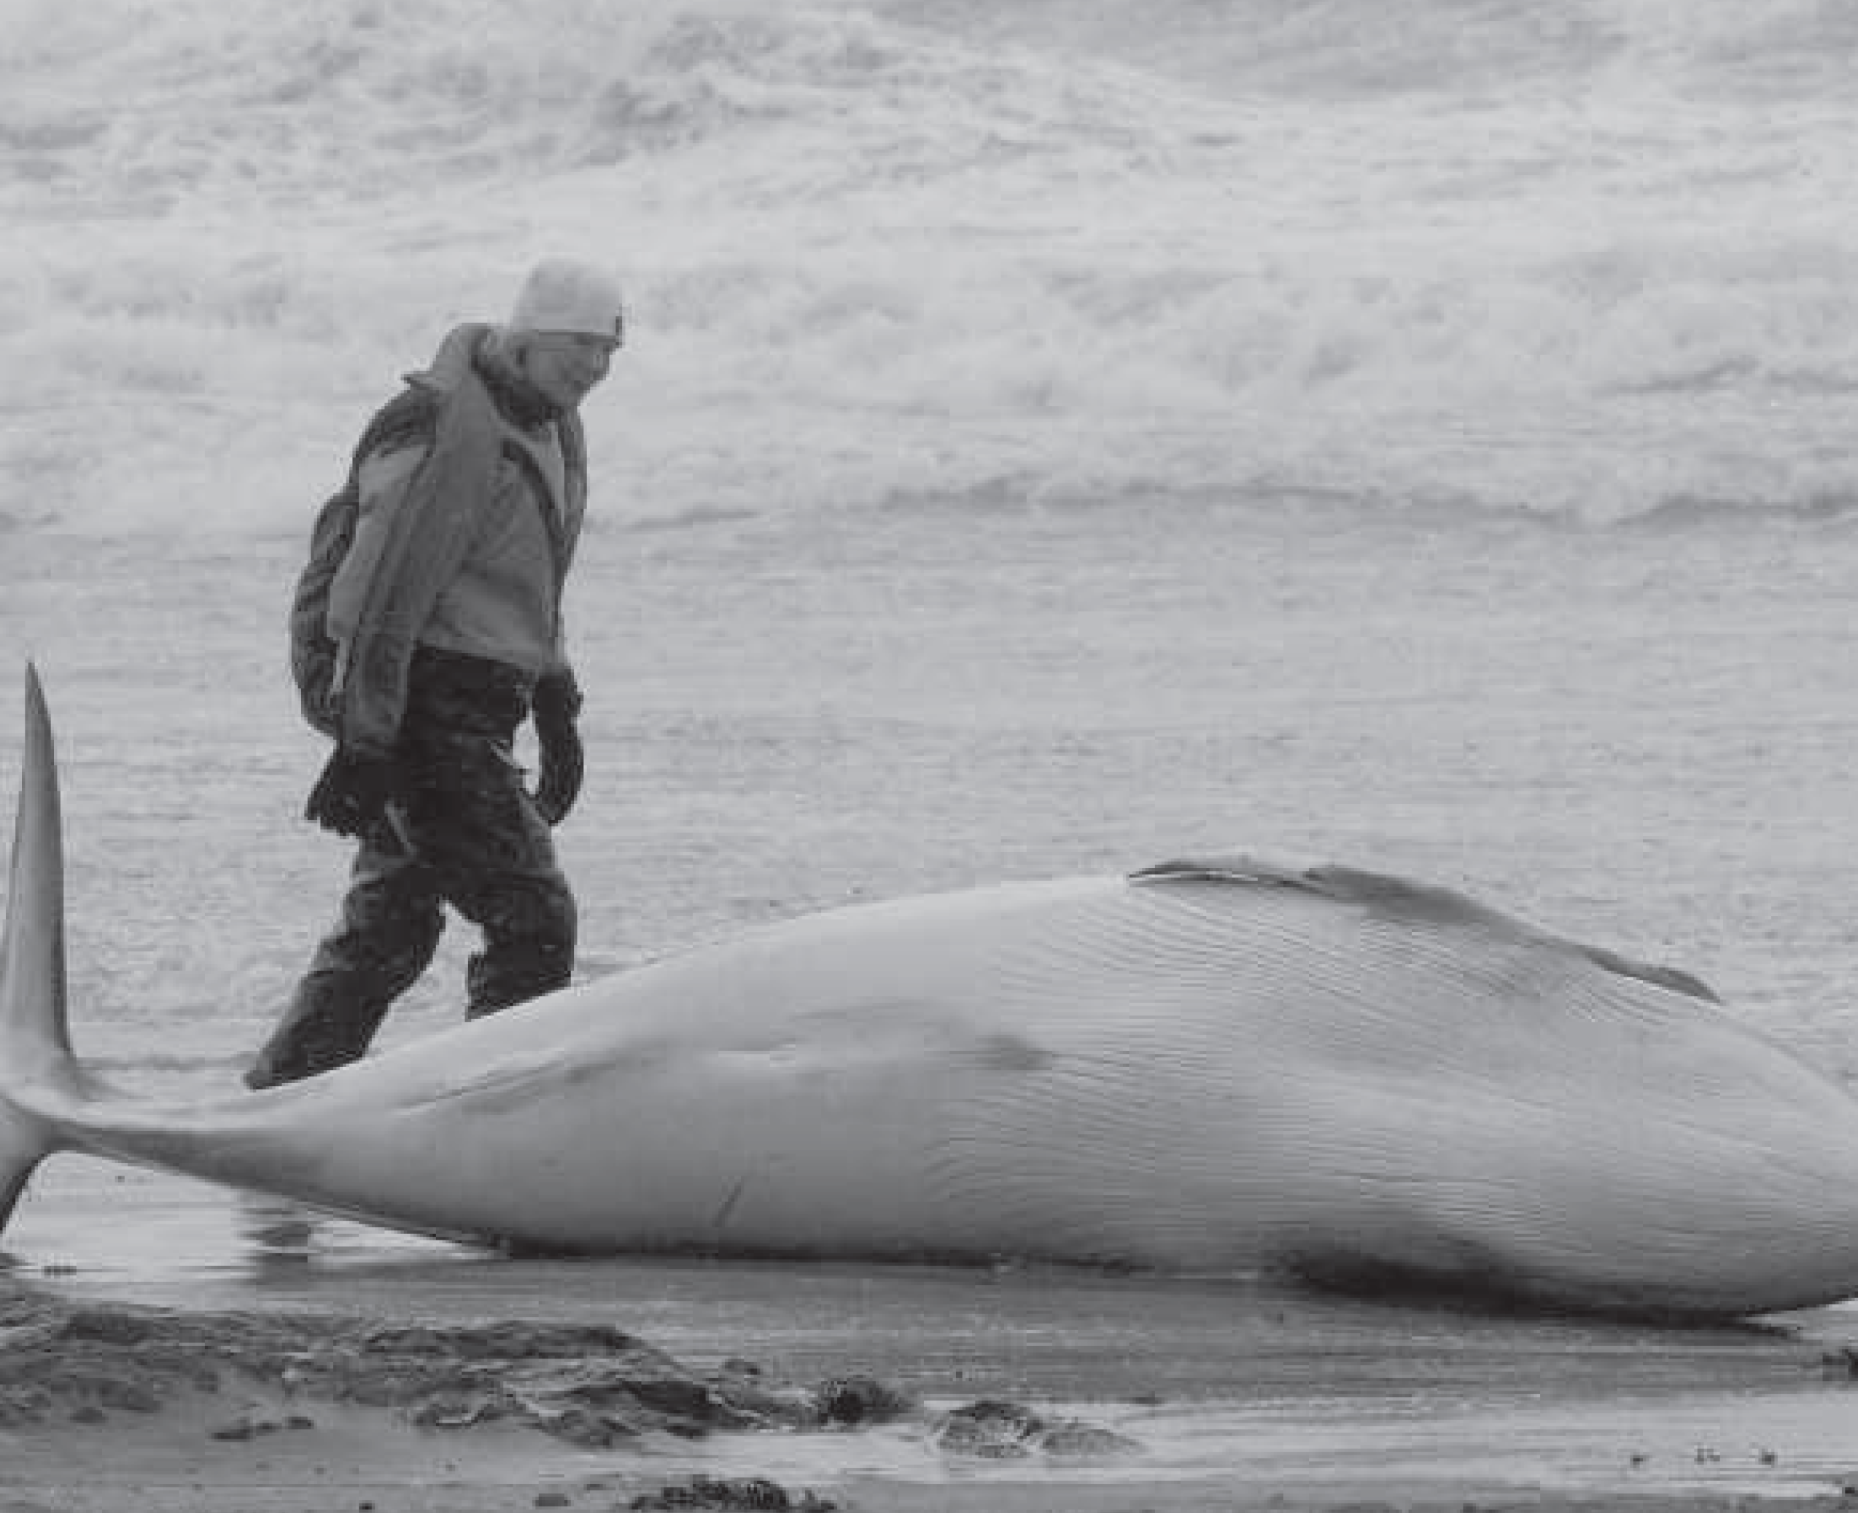
7 Complete the news item with the past simple and past perfect simple form of these verbs.
Rescuers in Scotland 1 _____________________ to return twenty whales to the sea this weekend. The whales 2 _____________________ from a larger group that 3 _____________________ stuck on the beach. Several other whales 4 _____________________ before the rescuers 5 _______________ help them. Earlier the rescue team 6 _____________________ unsuccessfully to stop the whales from coming too close to the shore. The reason for the whales’ behaviour is not clear.
managed
were
had become
had already died
were able to
had tried
3b-p. 23

Slide 18
8 Dictation a rescue
Listen and write the information from a news item about Coast Guards. When you hear ‘full stop’, this means you have reached the end of a sentence. Then put the sentences in order.
Track 19
a _______________________________________________________
_______________________________________________________
b _______________________________________________________
_______________________________________________________
c _______________________________________________________
_______________________________________________________
d _______________________________________________________
_______________________________________________________
e _______________________________________________________
_______________________________________________________
Both men are now in hospital.
The men had fallen out of their boat.
Their families had called the Coast Guard.
Coast Guards rescued two men from the sea this weekend.
because the men hadn’t returned from a fishing trip.
1 d 2 b 3 c 4 e 5 a or 1 d 2 c 3 e 4 b 5 a
3b-p. 23

Slide 19
Script
Track 19
a Both men are now in hospital.
b The men had fallen out of their boat.
c Their families had called the Coast Guard
d Coast Guards rescued two men from the sea this weekend.
e because the men hadn’t returned from a fishing trip.

Slide 20
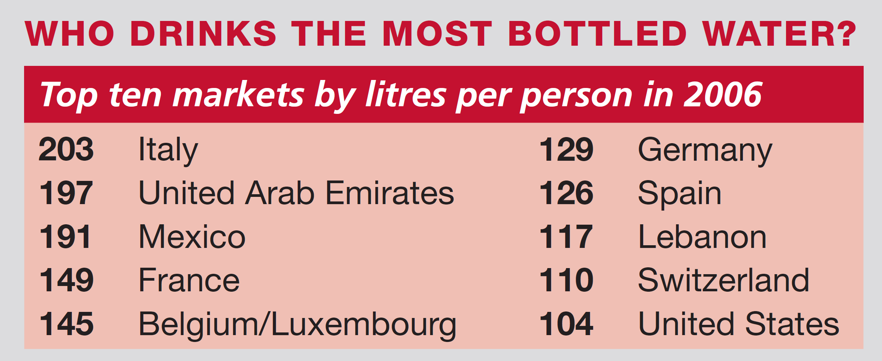
3c Bottled water
Listening water on tap?
1 Look at the information about bottled water. Where do people drink the most bottled water? ________________
Italy
3c-p. 24

Slide 21
2 Listen to part of a radio programme about Bundanoon, a bottled water free town in Australia. Answer the questions.
Track 20
1 Where does Bundanoon get its water from?
__________________________________________________________
2 What did the water company want to do?
__________________________________________________________
3 What had local businessman Huw Kingston done?
__________________________________________________________
__________________________________________________________
4 What happened at the town meeting?
__________________________________________________________
5 When did environmental groups start to support the town?
__________________________________________________________
__________________________________________________________
from an underground water reserve
to extract the water, bottle it and sell it as drinking water
He had written a letter to the newspaper about banning
bottled water.
The town decided to become ‘bottled water free’.
after national and international newspapers wrote articles about the story
3c-p. 24

Slide 22
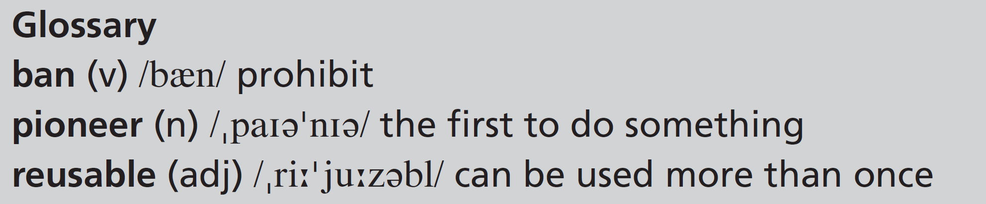
3 Listen again. Complete the sentences.
Track 20
1 The residents of Bundanoon were against the water company’s plans because ____________________________________________________.
2 Huw Kingston wanted the town to _______________________________ and _______________________________________________________.
3 A few residents heard about another Australian town that ___________________________________________________________.
4 The residents discovered that the carbon footprint of bottled water ___________________________________________________________.
5 If a visitor to Bundanoon wants some water, ___________________________________________________________.
they didn’t want to buy their own water in bottles
fight the water company
ban bottled water completely
had gone ‘plastic bag free’
is 300 times greater than tap water
they can get it from the tap
3c-p. 24

Slide 23
Script
Track 20
I = interviewer, P = Pauline
I: Now, you may remember seeing the name Bundanoon in the news headlines a while ago. Bundanoon is a small town near Sydney, Australia. It has its own supply of water from an underground water reserve. Some years ago, the residents of the town discovered that a water company had applied for permission to extract this water, bottle it, and sell it as drinking water. We spoke to Bundanoon resident Pauline Tiller earlier this week, about what happened next. Pauline, why didn’t you want this water company to go ahead with their plans?
P: Basically, because we were drinking the water in our homes, direct from our taps. We didn’t want to buy bottled water – especially when it was already our own town’s water supply!
I: And how did you get involved in the story?
P: Well, I was using an old newspaper to mop up a water leak one morning when something in the paper caught my attention. I stopped and read this astonishing letter Huw Kingston had written about banning bottled water.
I: Huw Kingston is a local businessman in Bundanoon, is that right?
P: Yes, he had come up with this revolutionary idea – he wanted the town to fight the water company. And he also wanted us to ban bottled water completely! As soon as I read his letter, I knew that was the answer!

Slide 24
Script
Track 20
I: And what did you do next?
P: A few residents got together to investigate how we could go ‘bottled water free’. At that time, we didn’t know we were pioneers! While we were looking for information, we heard about another Australian town that had gone ‘plastic bag free’. This really encouraged and inspired us. Then we found out that the carbon footprint of bottled water is 300 times greater than tap water! It became obvious that bottled water is a crazy idea. So we had a town meeting to discuss the whole thing and the town decided to become ‘bottled water free’.
I: And I believe journalists from a national newspaper arrived while you were holding the meeting?
P: Yes, a lot of national and international newspapers had heard about our story. After they wrote about us, we got a lot of support from environmental movements. And in September 2009, we became the first ‘bottled water free’ town in Australia.
I: So you banned bottled water. But now, what do people – visitors to the town, for example – do if they want to get a drink of water?
P: All the water in our town is free, so you can get it from the tap. And if you want to take some water with you, our shops sell our own ‘Bundanoon’ reusable bottles.

Slide 25
Word focus get
4 Look at these sentences from the radio programme. Replace the words in bold with four of these words. There is one extra word.
1 And how did you get involved in the story?
_______________________________
2 A few residents got together to investigate how we could go ‘bottled water free’.
_______________________________
3 After they wrote about us, we got a lot of support from environmental movements.
_______________________________
4 All the water in our town is free, so you can get it from the tap.
_______________________________
become
met
received
obtain
3c-p. 24

Slide 26
5 Match the comments (1–6) with the responses (a–f).
d
b
f
e
a
c
1 How did you get on at the meeting?
2 This company wants to bottle the town’s water.
3 Can you get me a paper when you go to the shop?
4 How’s the campaign going?
5 How did you get your picture in the papers?
6 What a crazy week!
a We just got in touch with the journalists about the campaign.
b I don’t get it. Why do they want to do that?
c I know! I can’t wait for things to get back to normal.
d Really well. They agreed to all of our suggestions.
e Things are getting better now that we’ve been on TV.
f Yes, sure.
3c-p. 24

Slide 27
3d No way!
Real life telling stories
1 Complete the story with these words.
Did I ever tell you about the time I went fishing with my girlfriend’s father?
1 ____________ the drive to the lake, he told me about all the huge fish he’d caught. 2 ____________ half an hour of this, I wanted to go home. Anyway, we’d been on the lake for a couple of hours when 3 ___________, my fishing rod started to move. 4 ____________ I was trying to bring the fish in, he was shouting, ‘It’s massive, really big!’ Thirty minutes
5 ____________, I still hadn’t managed to get the fish in the boat. And
6 ____________ I dropped my rod in the water. My girlfriend’s father was horrified. He never spoke to me again.
During
After
suddenly
While
later
then
3d-p. 25

Slide 28
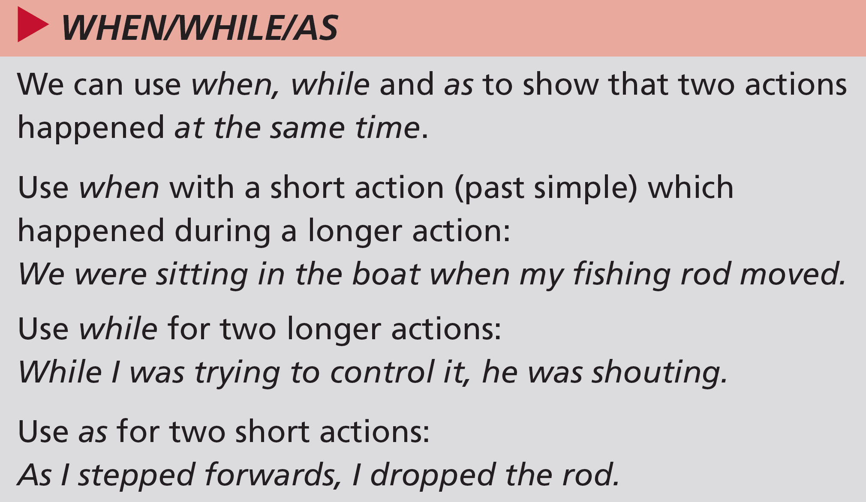
2 Grammar extra when/while/as
Choose the best option.
1 We were driving to the river while / when we ran out of petrol.
2 As / While I got out of the car, I felt the rain.
3 While / When we were putting petrol in the car, the sky was getting darker.
4 As / When I walked to the till, I decided to go home.
5 We were talking about our plans while / when my phone rang.
6 As / While I got back home, the sun came out.
3d-p. 25

Slide 29
3 Pronunciation was and were
a Listen and repeat the sentences you hear. Pay attention to how you say was and were.
Track 21
b Now practise saying sentences 1, 3 and 5 from Exercise 2.
Script
Track 21
1 We were fishing on the lake.
2 I was trying to bring the fish in.
3 He was shouting at me.
4 We were sitting in the boat.
3d-p. 25

Slide 30
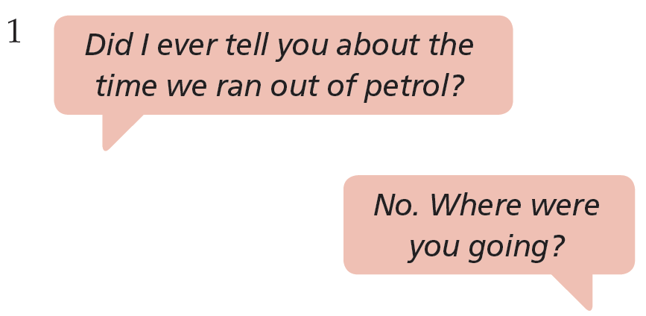
4 Listen and respond asking about things that happened
Track 22
Listen to people talking about things that happened to them. Respond with a question. Use your own words. Then compare your response with the model answer that follows.
3d-p. 25

Slide 31
Script
Track 22
1 Q: Did I ever tell you about the time we ran out of petrol?
R: No. Where were you going?
2 S: I remember when I broke my leg.
R: When did that happen?
3 S: I almost had a car accident last night.
R: Really? What happened?
4 S: A couple of months ago, I decided to leave my job.
R: Oh? Why?
5 S: You’ll never believe who we saw in town at the weekend!
R: Oh? Who was it?
6 Q: Did I tell you what I was doing when you phoned?
R: No. What were you doing?

Slide 32
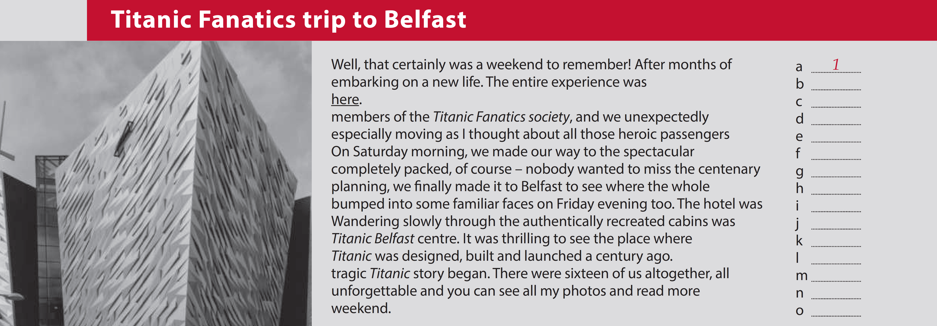
3e What a weekend!
Writing a blog post
1 Jenna’s computer has made a mess of her blog. Put the text in the correct order. Write numbers next to the lines.
Well, that certainly was a weekend to remember! After months of embarking on a new life. The entire experience was here.
members of the Titanic Fanatics society, and we unexpectedly especially moving as I thought about all those heroic passengers On Saturday morning, we made our way to the spectacular completely packed, of course – nobody wanted to miss the centenary planning, we finally made it to Belfast to see where the whole bumped into some familiar faces on Friday evening too. The hotel was Wandering slowly through the authentically recreated cabins was Titanic Belfast centre. It was thrilling to see the place where Titanic was designed, built and launched a century ago.
tragic Titanic story began. There were sixteen of us altogether, all unforgettable and you can see all my photos and read more weekend.
1
a ____
b ____
c ____
d ____
e ____
f ____
g ____
h ____
i ____
j ____
k ____
l ____
m ____
n ____
o ____
13
15
4
12
8
6
2
5
11
9
10
3
14
7
3e-p. 26

Slide 33
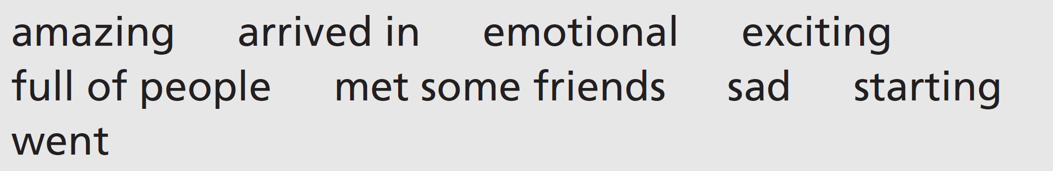
2 Writing skill interesting language
a Match these words with the expressions Jenna used.
1 we finally made it to Belfast: _________________________
2 tragic story: _________________________
3 we bumped into some familiar faces: _________________________
4 packed: _________________________
5 we made our way to: _________________________
6 spectacular: _________________________
7 thrilling: _________________________
8 moving: _________________________
9 embarking on a new life: _________________________
arrived in
sad
met some friends
full of people
went
amazing
exciting
emotional
starting
3e-p. 26

Slide 34
b Complete the sentences with some of the words Jenna used from Exercise 2a.
1 The new building is ____________________.
2 I ____________________ my boss at the cinema.
3 It was rush hour, so the bus was ____________________.
4 I got on the train and ____________________ to my seat.
5 I was surprised to see ____________________ at the exhibition.
6 This young boy had a ____________________ life before going to America.
spectacular
bumped into
packed
made my way
familiar faces
tragic
3e-p. 26

Slide 35
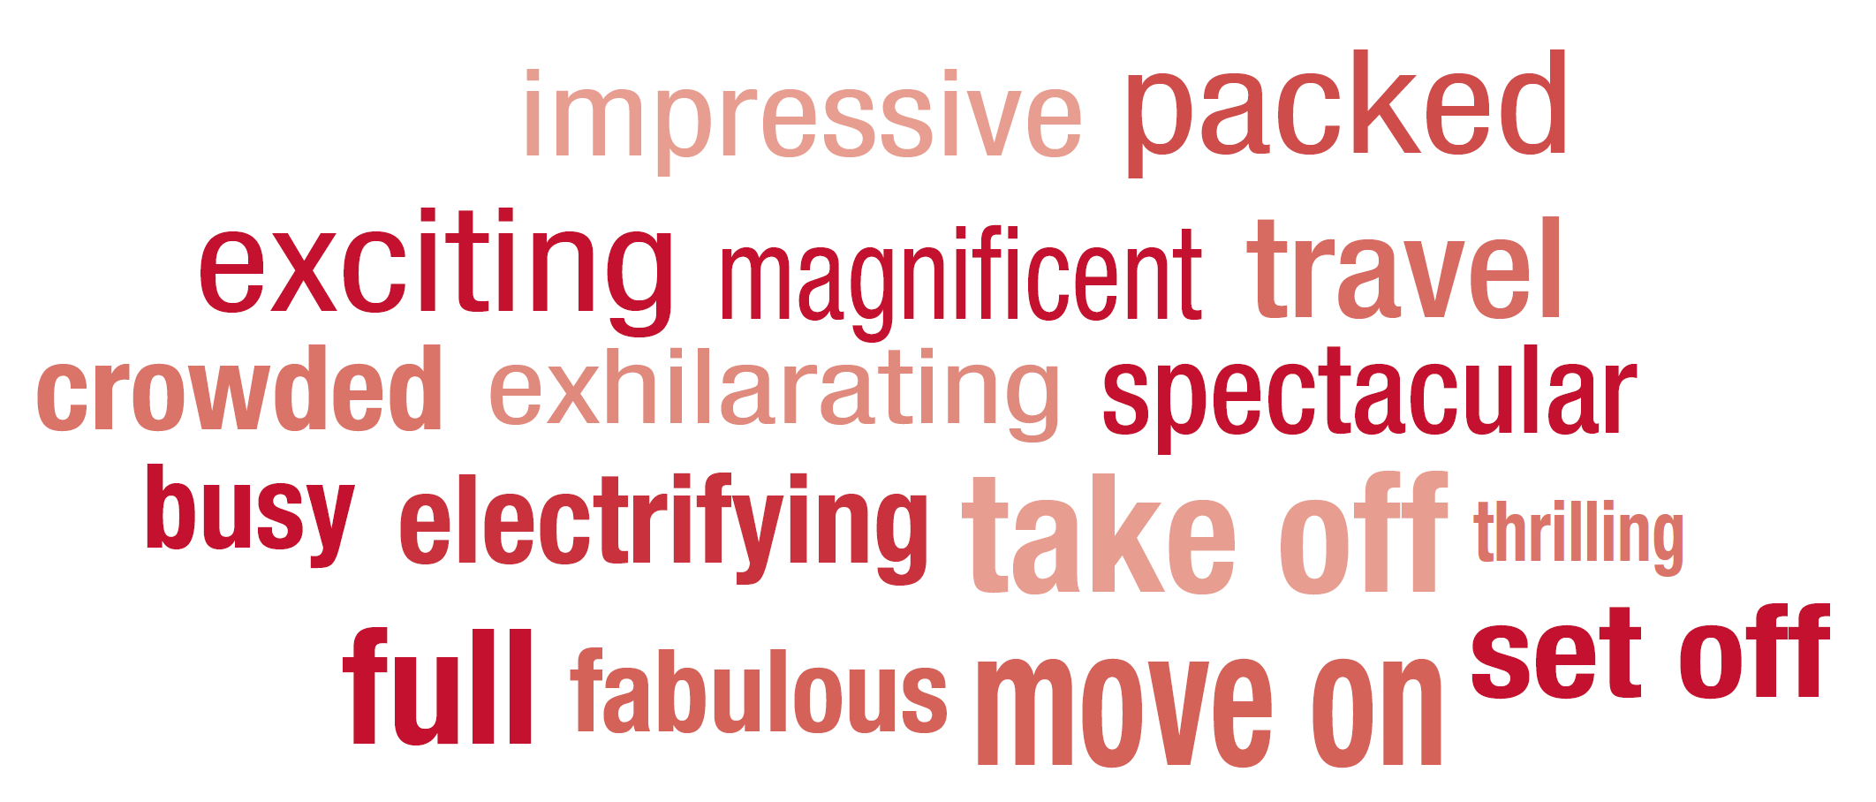
3 Look at the words. Find four words to describe:
1 a view: ____________, ____________, ____________, ____________
2 an experience: ____________, ____________, ____________, ____________
3 a place you are in: ____________, ____________, ____________, ____________
4 ways of ‘going’: ____________, ____________, ____________, ____________
fabulous
impressive
magnificent
spectacular
electrifying
exciting
exhilarating
thrilling
busy
crowded
full
packed
move on
set off
take off
travel
3e-p. 26

Slide 36
4 Use these notes to write the second part of Jenna’s blog.
• Saturday evening / got dressed up
• dinner / spectacular dining room
• whole thing / re-creation / dinner on Titanic
• dining room / packed / thrilling / authentic costumes
• bumped into / people / earlier / joined
• food / amazing / whole thing / moving
Model answer:
On Saturday evening, we all got dressed up and went to dinner in the spectacular dining room. The whole thing was a re-creation of dinner on Titanic. The dining room was packed and it was thrilling to see everyone in authentic costumes. We bumped into some people we had met earlier and they joined our group. The food was amazing too and the whole thing was very moving.
3e-p. 26

Slide 37
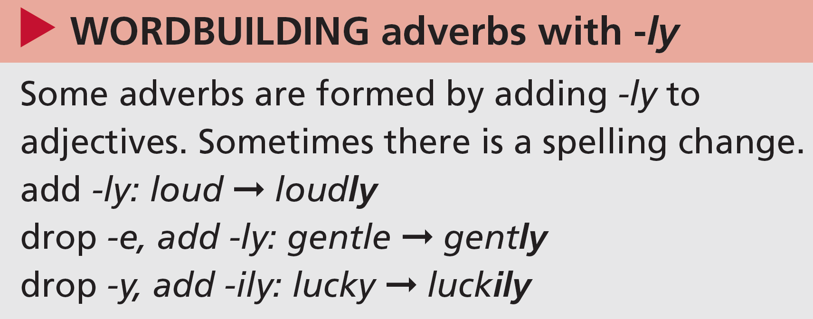
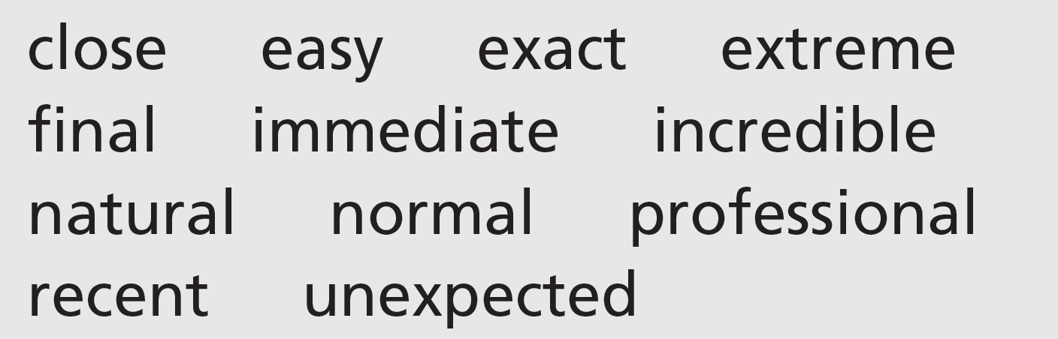
Wordbuilding adverbs with -ly
1 Make adverbs from these adjectives.
closely, easily, exactly, extremely, finally, immediately, incredibly, naturally, normally, professionally, recently, unexpectedly
3e-p. 27

Slide 38
2 Complete these sentences using adjectives or adverbs from Exercise 1. Sometimes you can use more than one adverb or adjective.
1 When I saw the shark, I felt ___________________________ frightened!
2 We’ve had lots of visitors ___________________________.
3 Jack always works in a very ___________________________ way.
4 We need to arrive at ___________________________ one o’clock.
5 Sue’s underwater photos are just ___________________________!
6 There were a lot of cars, but to our surprise we parked ___________________________.
extremely
recently
natural, normal, professional
exactly
incredible
easily, immediately
3e-p. 27

Slide 39
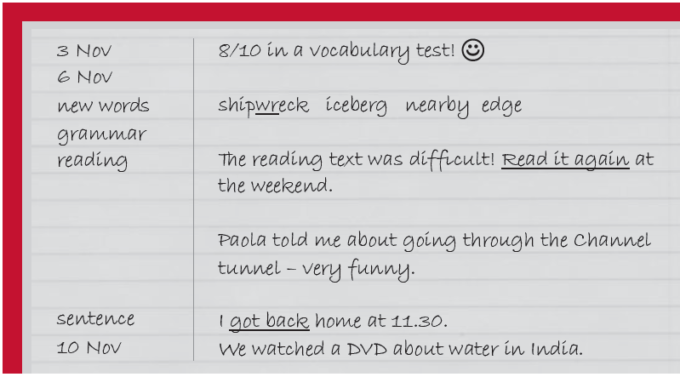
Learning skills keeping a journal
3 Keeping a journal can help you remember everything. Look at the page from a journal and tick (✓) the things the student has included.
The student includes the following things:
• diagrams/drawings
• example sentences
• grammar
• how he/she feels about something
• listening
• other students
• pictures
• questions for the teacher
• reading
• reminders to do things
• self-evaluation
• speaking
• test scores
• vocabulary
• writing
✓
✓
✓
✓
✓
✓
✓
(entry for 10 Nov)
3e-p. 27

Slide 40
4 Look at the things in the diary entry which are underlined. Why do you think the student has underlined them?
because they are important
5 Choose the options which work best for you. Then try keeping a journal for a month.
1 type of journal: notebook / computer-based / online blog
2 entries: every day / after every class / every week
3 type of entry: notes / a narrative / analytical
4 focus: what I learn / how I learn / strong points / weak points
5 re-read: after each entry / every week / every fortnight
3e-p. 27

Slide 41
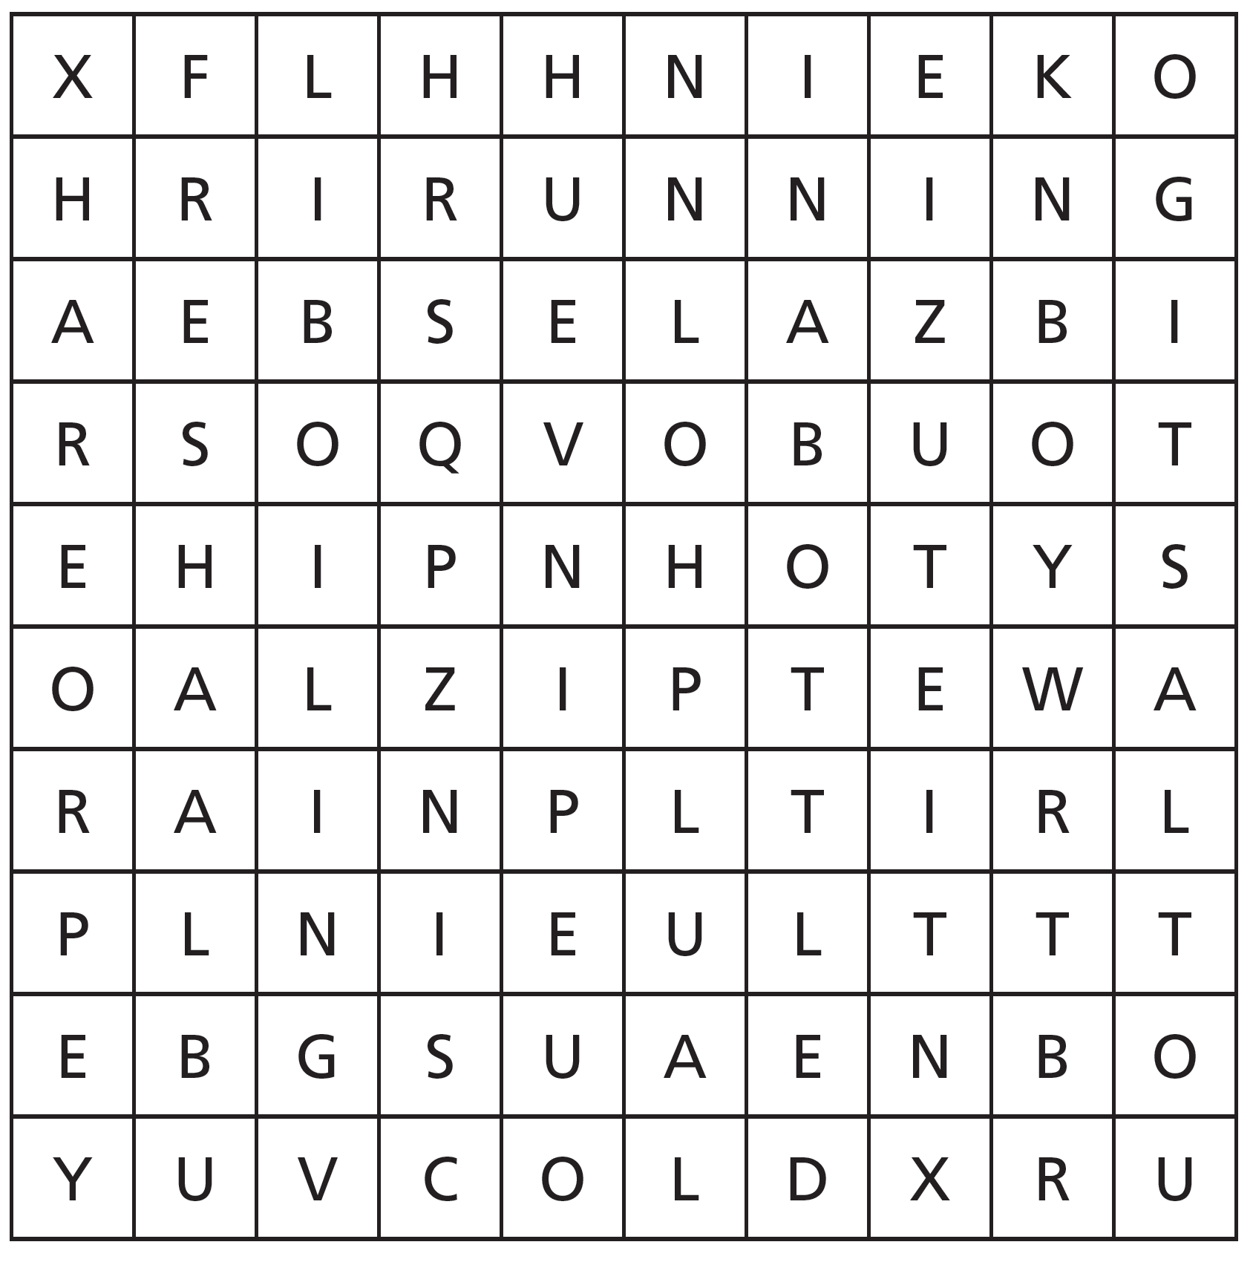
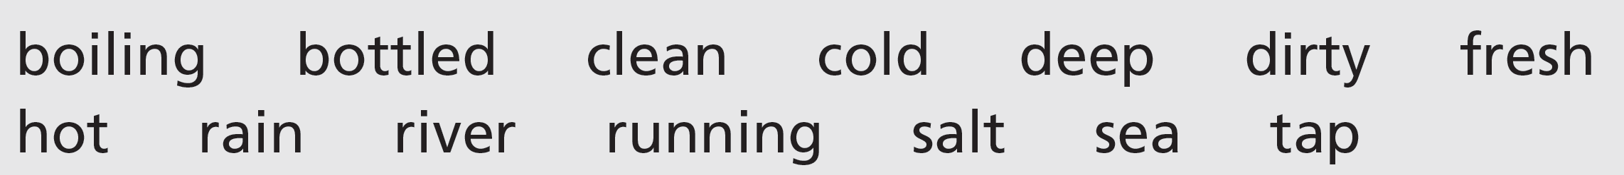
Check!
6 All these words go with water. Which ones are in the word square? Use the clues to help you.
1 It falls from the sky and you can collect it in a tank.
2 Some people only drink this kind, but it’s expensive.
3 Lakes are almost always this kind of water.
rain
bottled
fresh
4 When your home gets a continuous supply from pipes.
5 If you’re in this kind of water, it means you have done something wrong.
6 This kind is needed to make a cup of tea.
7 The oceans and seas of the world are made of this.
8 When you don’t like an idea, you pour this kind of water on it.
running
boiling
hot
salt
cold
3e-p. 27

